Slide 1
Live, Continuous Energy Auditing of Miscellaneous Electrical Loads: Methodology and Results
Jorge Ortiz
Jason Trager, Gavin Saldanha, Yongwoo Noh, David Su,
David Culler, Paul Wright
UC Berkeley
2012 ACEEE Summer Study on Energy Efficient Buildings
August 13, 2012
Pacific Grove, CA

Slide 2
Outline
Challenges in plug-load data collection
Prior work
System architecture
Results

Slide 3
Plug-loads consume 1/3 of building energy
73% of total energy produced, consumed in buildings
~30% is consumed by plug-loads
Plug-loads are
categorically fragmented
spread throughout the building
constantly changing
US Building Energy Use, 2010

Slide 4
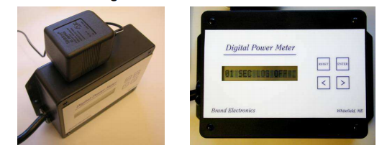
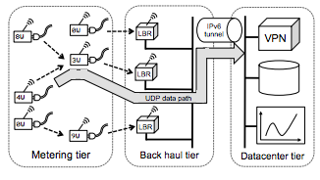
Prior work
Porter et al., 2006
Sampled 50 homes. 17 devices per home for one week.
Moorefield et al., 2008
Sample 47 offices. 10 devices per office for two weeks.
Lanzisera et al., 2011
Entire building metered. 455 devices over wireless multihop.
Notes:
From Porter et al. “The meters contain a standard, grounded wall plug receptacle capable of measuring the voltage, current, power, and power factor of any plug load device with a power consumption of less than 500 watts. Once installed by a field technician, the meters logged these parameters at one-minute intervals for a period of one week. Sites were revisited after one week for meter pickup and data collection. Field technicians turned off any equipment being metered and then disconnected the products from the One Meters. RLW Analytics
field technicians then extracted the data, uploaded the data to an FTP site, reset the meters, and prepared them for their next site visit the following week.”

Slide 5
High, continuous management overhead
In Lazisera et al. collecting inventory information took weeks!
Extensive classification taxonomy
Careful info collected of 5000 plug-loads by two-person team.
Manually inputted into relational DB
Management problems
Meters broke, devices were removed, new items plugged into certain meters
Management headache!
…for a system that was mainly built to study only plug-loads
Notes:
From @scale paper:
“Due to the diversity of devices, a standardized system of identifying and recording MELs is essential for inventory and energy data analysis. We updated an extensive taxonomy developed in [23] to include new device types found today, such as tablet computers. The taxonomy consists of three levels: End Use, Category, and Product Type. MELs are divided into three major end uses -- Electronics, Miscellaneous, and Traditional. Each end use is in turn composed of categories, and each category contains many product types. The inventory categorized every plug-load in the building according to this taxonomy, resulting in the identication of almost 5,000 devices. The inventory was collected by two-person teams and recorded in a relational database.”

Slide 6
Design goals
Make it easier to collect plug-load information, directly
Design for incremental deployment and scale
Derive continuous value from infrastructure
Leverage building occupants where possible

Slide 7
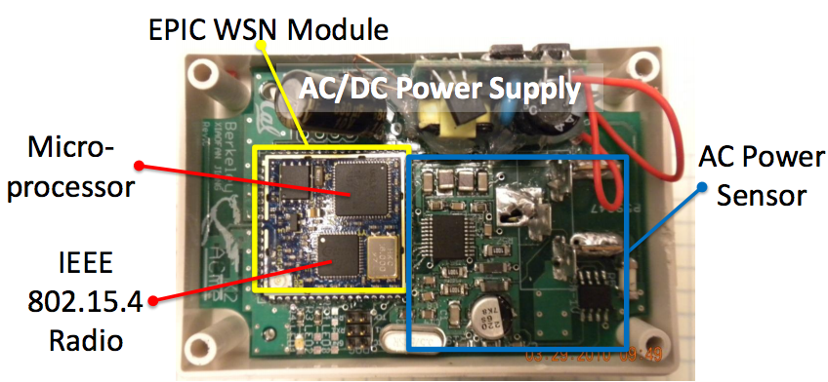
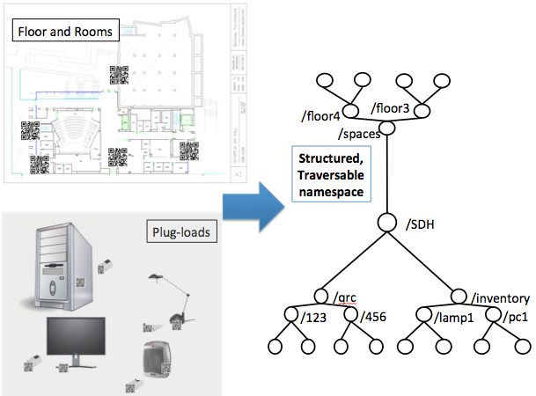
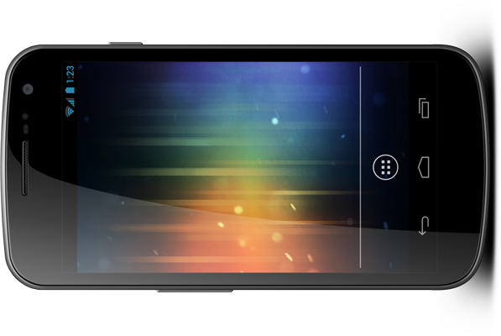
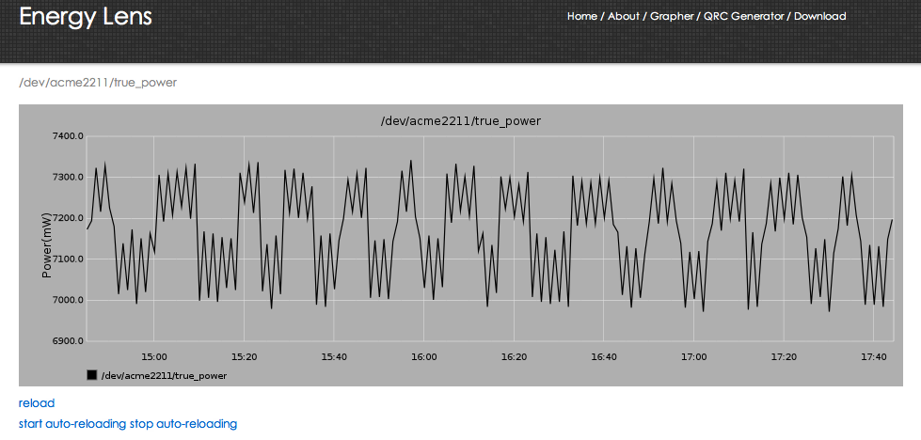

Energy Lens high-level architecture
ACme sensors
Cloud
sMAP, StreamFS
Mobile phones
Cheap tags
Incrementally
Deployable
Owned by occupants
Incrementally
Deployable
Accepts any streaming data
Notes:
QR codes are cheap, Acmes are $20-50 in bulk, Everyone has a phone

Slide 8
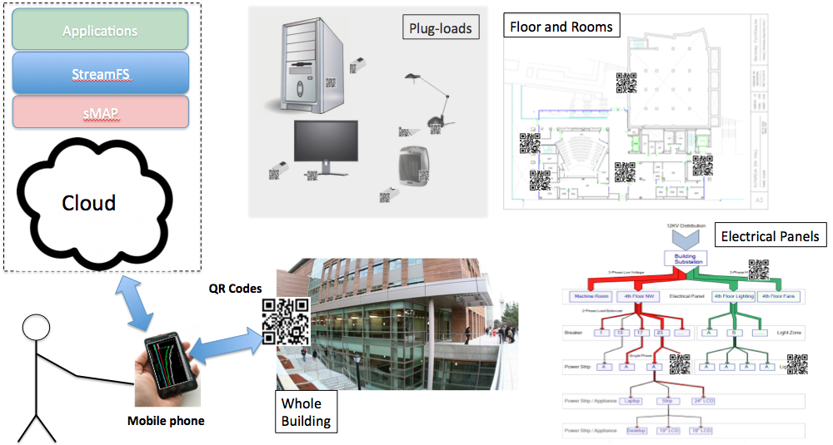
Metadata about physical deployment mandatory
Tag everything
Use phone to input information about things…
Classification, location, type, etc.
…and the relationship between things
Necessary to interpret context of streaming data
Notes:
What relationships are important to capture?
Location
Meter-to-load relationship (…over time)

Slide 9
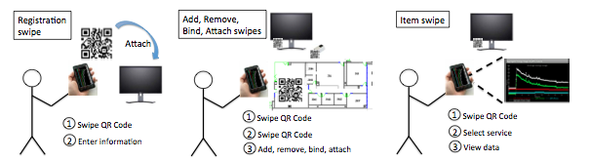
QR Swipes for information collection

Slide 10
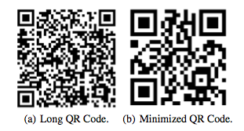
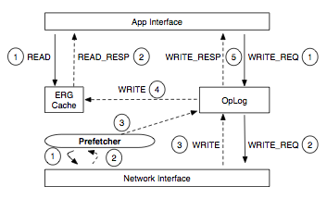
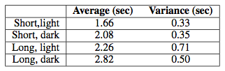
Deployment Challenges
Lighting and camera quality
Ubiquitous network access

Slide 11
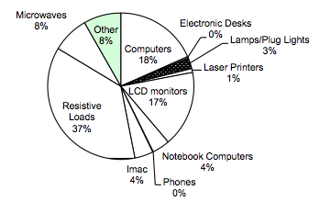
Results
Sutardja Dai Hall @UCB
141,000 sq. ft.
Registered and classified
20 meters
20 metered items
351 un-metered items
139 rooms
7 floors
Information collected in approx. 2-3 hours

Slide 12
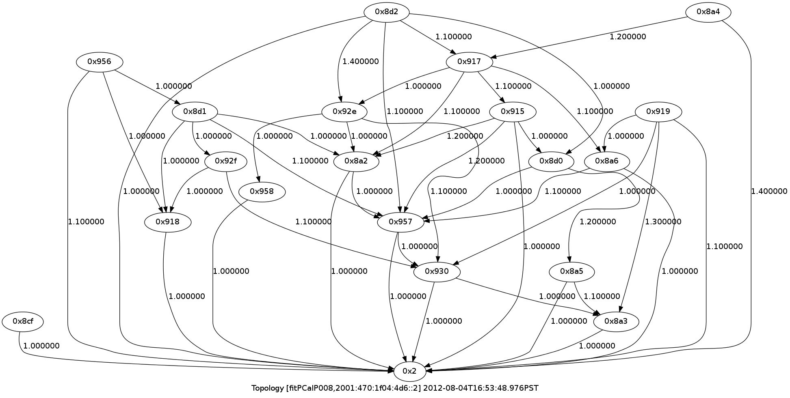
ACme IPv6 multihop network

Slide 13
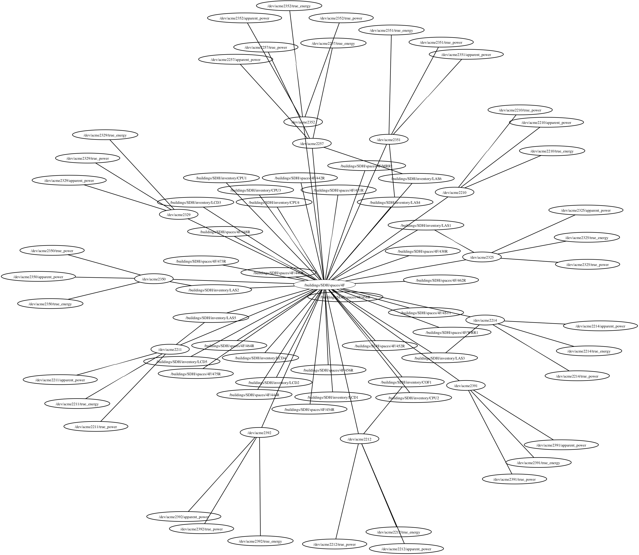
Entity-relationship graph 4th floor SDH

Slide 14
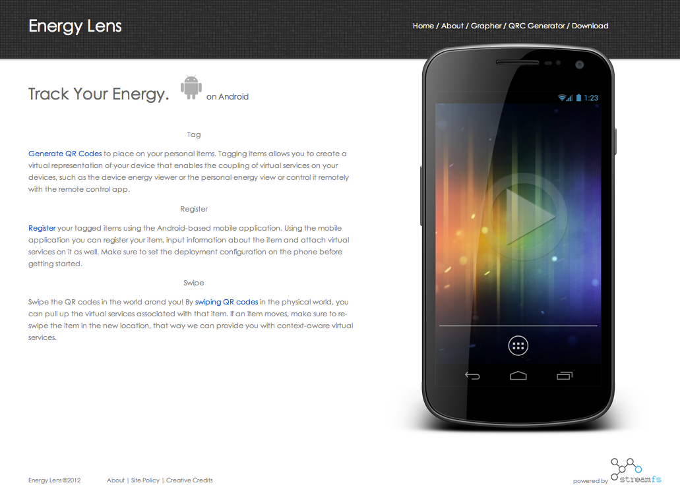
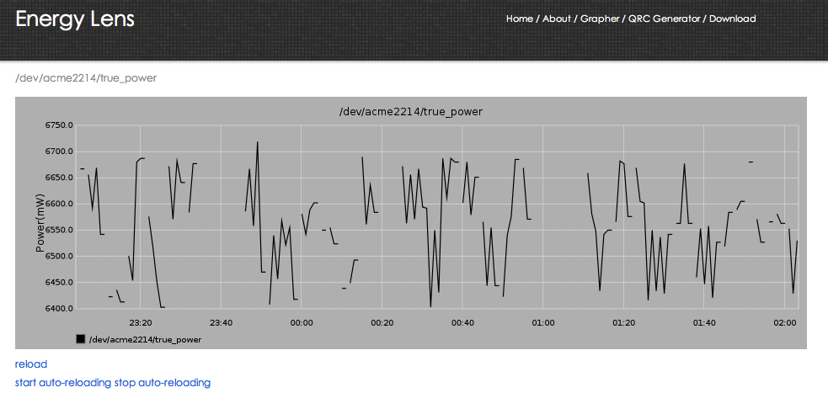
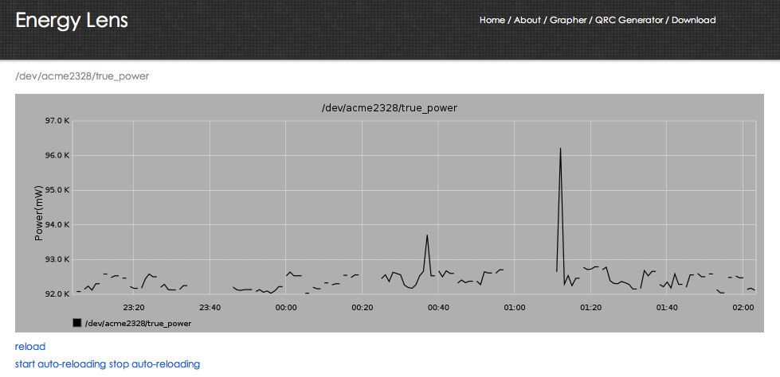
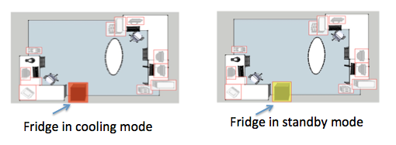
Applications built on infrastructure
Continuous value
derived from Infrastructure

Slide 15
Keys takeaways
Skip the written step
Infrastructure should build incrementally
Infrastructure should provide continuous value
Involve building occupants when possible

Slide 16
Thank you and questions
More information
http://streamfs.cs.berkeley.edu
http://energylens.is4server.com
Contact
http://www.eecs.berkeley.edu/~jortiz

Slide 17
Extra

Slide 18
Tracking context with swipes
When a user swipes at a location L, they are presumed to be at L for fixed period t . An “association timer”
If the user swipes anything that is associated with a location l at time t <=T , and l(t) != L, then we set the new location of the thing they swiped to l(t) and reset the association timer.
If the user swipes anything at location l at time t >=T , we set the location of the person to l(t). We reset the association timer to T .
If a user registers a new location, they are presumed to be at that location.

